Slide 1
Chapter 8: Managing Local Storage
Instructor-led overview and operational guidance

Slide 2
Learning Objectives
01 Explain the key administrative ideas in Chapter 8
02 Identify the relevant Windows Server tools, workflows, and decision points
03 Relate the topic set to real operational and security practices
04 Prepare for later hands-on administration and troubleshooting work
Windows Server 2025 | Chapter 8 | Managing Local Storage
02

Slide 3
Chapter Topics
01 8.1 Disks
02 8.2 Partitions
03 8.3 Volumes
04 8.4 NTFS
05 8.5 ReFS
06 8.6 RAID
07 8.7 Mount points
08 8.8 Storage Spaces and Storage Replica

Slide 4

8.1 Disks
Disks are the physical or virtual storage devices that form the starting point of local storage configuration in Windows Server.
Physical disks and virtual disks
Online and offline state
Initialization and management
Windows Server 2025 | Chapter 8 | Managing Local Storage
04

Slide 5

8.2 Partitions
Partitions divide disk space into manageable regions that can later host volumes and filesystems.
Partition styles and layout
Reserved and usable regions
Relationship to volumes
Windows Server 2025 | Chapter 8 | Managing Local Storage
05

Slide 6
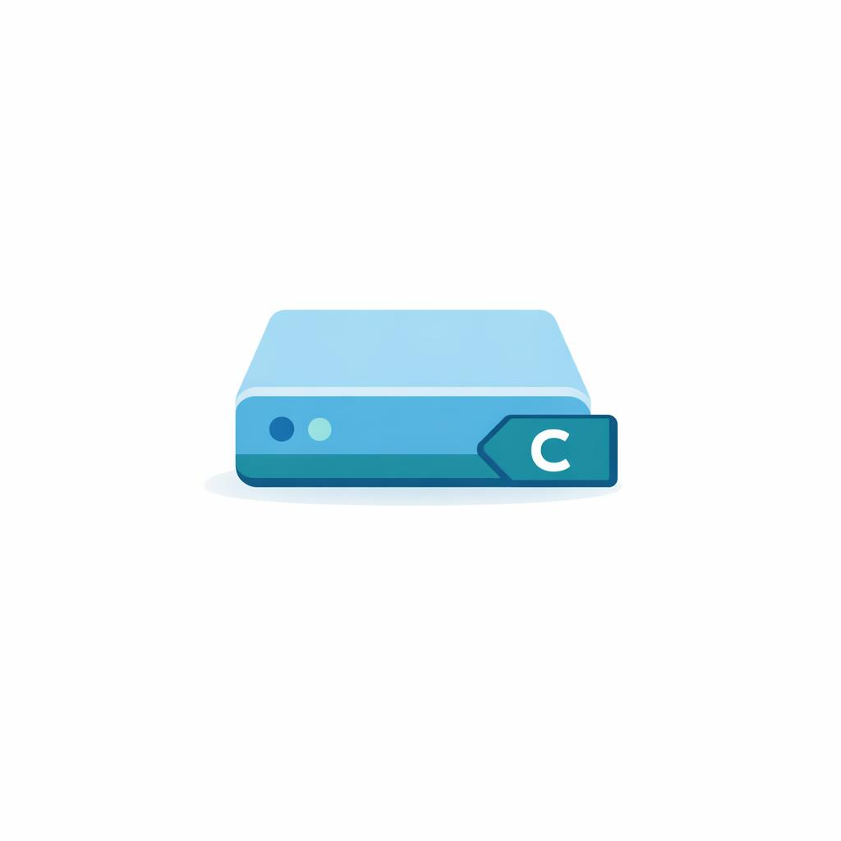
8.3 Volumes
Volumes are the storage units exposed to the operating system for formatting, drive-letter assignment, and workload use.
Simple storage allocation
Drive letters and mount paths
Formatting and capacity management
Windows Server 2025 | Chapter 8 | Managing Local Storage
06

Slide 7

8.4 NTFS
NTFS is the long-standing default filesystem for Windows Server and provides permissions, journaling, quotas, and many enterprise features.
ACL-based security
Metadata and journaling
Compatibility with common server workloads
Windows Server 2025 | Chapter 8 | Managing Local Storage
07

Slide 8

8.5 ReFS
ReFS is the Resilient File System designed for integrity, resiliency, and specific Windows Server storage scenarios.
Integrity streams and resilience features
Modern storage scenarios
Differences from NTFS behavior
https://learn.microsoft.com/en-us/windows-server/storage/refs/refs-overview
Windows Server 2025 | Chapter 8 | Managing Local Storage
08

Slide 9

8.6 RAID
RAID is a storage resiliency and performance concept that Windows administrators need to understand even when implemented in hardware, firmware, or software layers.
Redundancy and striping concepts
Tradeoffs between performance and resilience
Windows Server storage implications
Windows Server 2025 | Chapter 8 | Managing Local Storage
09

Slide 10
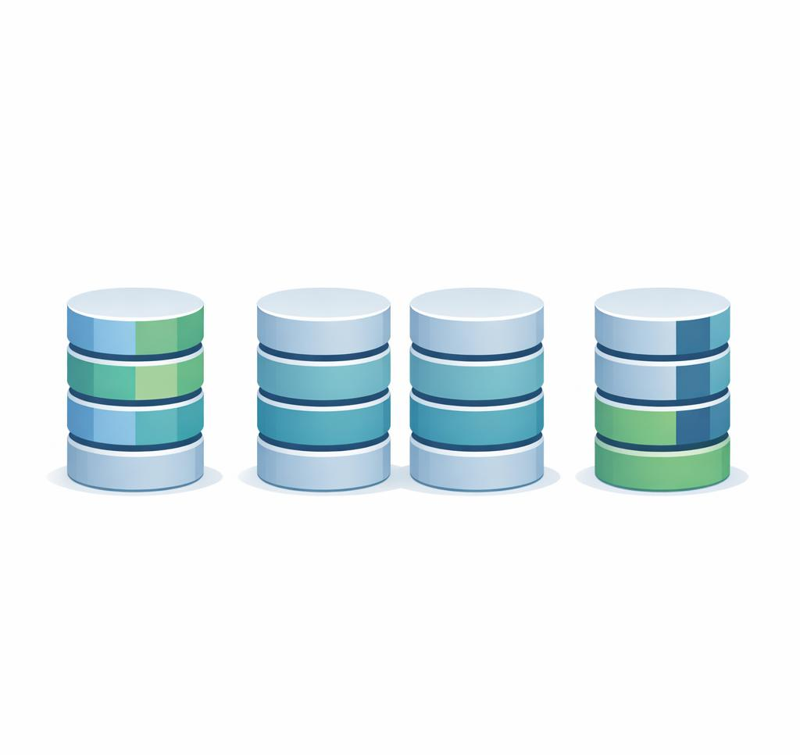
RAID: Common Levels at a Glance
Striping (performance, no redundancy)
RAID 0: stripes data across 2+ disks for speed; one failure = total loss
Mirroring (redundancy via copies)
RAID 1: two-disk mirror; survives one failure, 50% capacity overhead
RAID 10: stripe of mirrors; combines RAID 1 redundancy with RAID 0 speed, expensive
Parity (redundancy via math)
RAID 5: stripe + distributed parity (≥3 disks); survives 1 failure; slow rebuilds on large drives
RAID 6: stripe + dual parity (≥4 disks); survives 2 simultaneous failures
Windows Server 2025 | Chapter 8 | Managing Local Storage
10

Slide 11
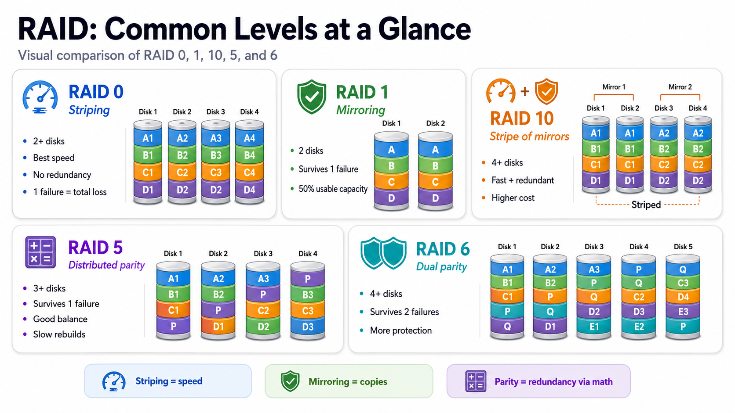

Slide 12
RAID Today: Less Central, Still Useful
Why RAID has receded
Where RAID still fits
Multi-TB RAID 5 rebuilds can take days and expose a second-failure risk
Storage Spaces, S2D, and ZFS add resiliency with stronger integrity checks
Cloud and hyper-converged designs replicate above the physical disk layer
Flash and NVMe can make the hardware RAID controller the bottleneck
RAID 1 boot mirrors remain a simple way to protect the operating system
Small servers and branch offices may still benefit from hardware RAID
Single-volume LUN appliances may not support software-defined pools
Backup and archive targets may favor familiar, well-understood redundancy
Windows Server 2025 | Chapter 8 | Managing Local Storage
11

Slide 13
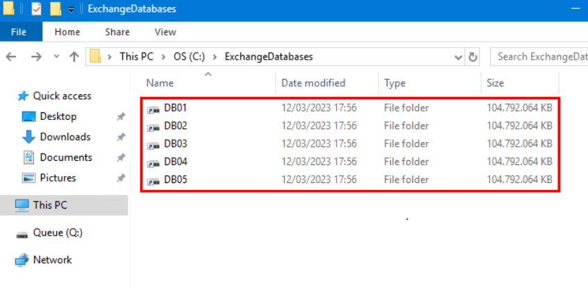
8.7 Mount points
Mount points allow administrators to expose storage through folder paths instead of only through drive letters.
Folder-based storage access
Drive-letter conservation
Relationship to volume management
Windows Server 2025 | Chapter 8 | Managing Local Storage
12

Slide 14
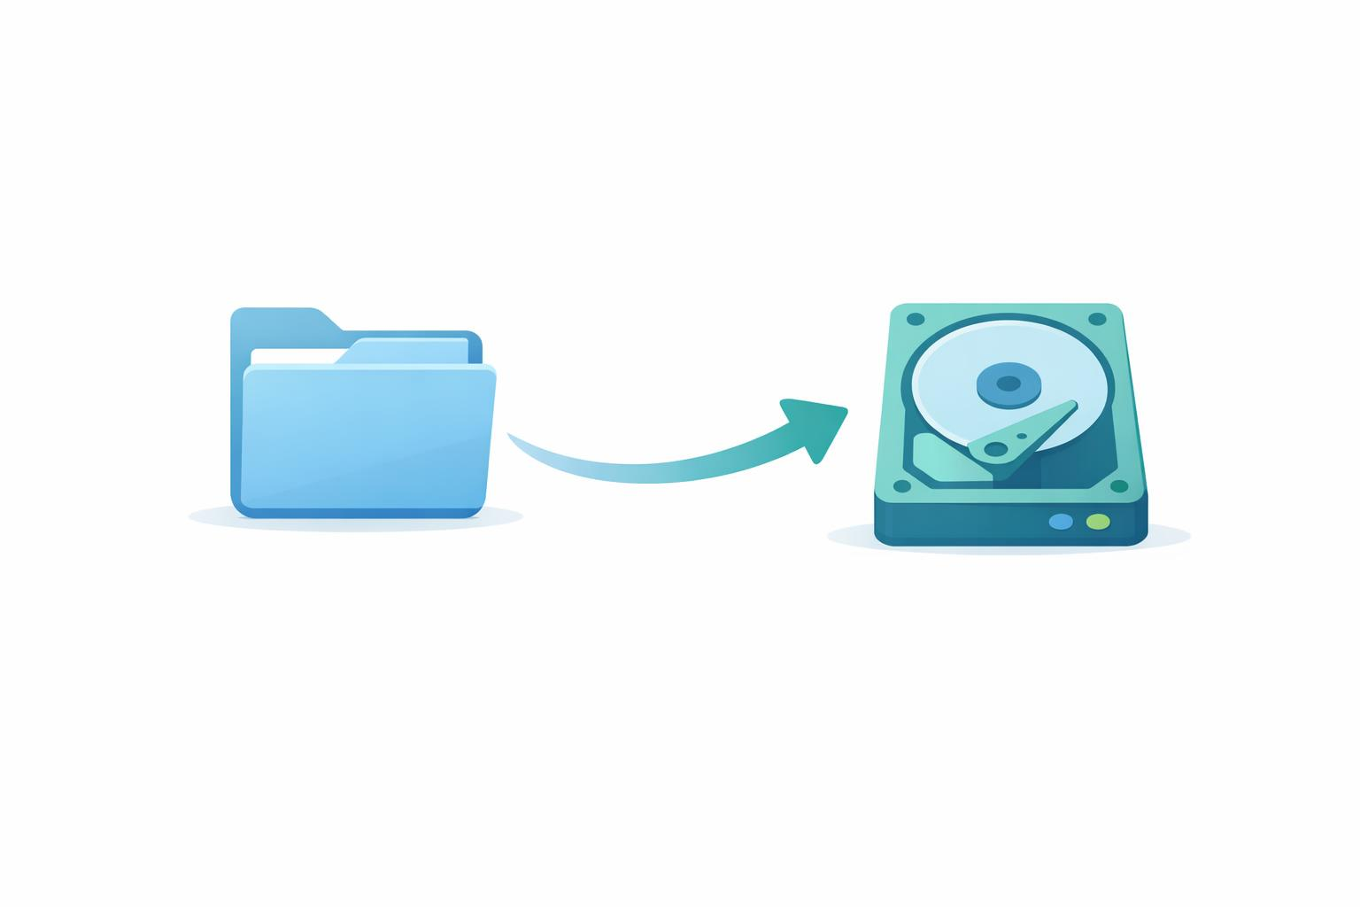
Mount Points: Paths and Benefits
What Is a Mount Point?
A mount point is an empty NTFS folder that provides access to another storage volume, instead of using a separate drive letter.
Not the same as a shortcut — handled at the filesystem level and fully transparent to applications.
E:\ → C:\Data\Archive
traditional drive letter mount point path
Key Benefits
Conserve drive letters on servers with many volumes
Create a cleaner, more logical folder structure
Expand storage transparently without changing application paths
Support workloads like file servers, SQL Server, backups, and large data stores
Windows Server 2025 | Chapter 8 | Managing Local Storage
13

Slide 15
8.8 Storage Spaces and Storage Replica
Storage Spaces and Storage Replica solve different storage problems
Pooling is not the same as replication
Resilience, replication, and backup should not be confused
Windows Server 2025 | Chapter 8 | Managing Local Storage
14

Slide 16
Storage Spaces: Overview
What it is
Software-defined storage that pools physical disks into one or more storage pools
Carves virtual disks (storage spaces) from the pool — appear to Windows as regular disks
Provides resiliency, thin provisioning, and tiering without a hardware RAID controller
Why it matters
Cheaper than SAN or hardware RAID — uses commodity SAS/SATA drives and simple HBAs
Foundation for Storage Spaces Direct (S2D), the clustered hyper-converged version
Survives disk failure with mirror or parity layouts; pool grows by adding more disks
Windows Server 2025 | Chapter 8 | Managing Local Storage
15

Slide 17
Storage Spaces: Resiliency Layouts
Simple
Stripes data across disks (like RAID 0) — fastest, no redundancy, single disk failure = data loss
Mirror
Two-way mirror: 2 copies, survives 1 disk failure (50% capacity overhead)
Three-way mirror: 3 copies, survives 2 simultaneous failures (67% overhead)
Parity
Stripes with parity (like RAID 5/6) — best capacity efficiency, slower writes
Single parity needs ≥3 disks; dual parity needs ≥7 disks (S2D)
Mirror-accelerated parity (S2D)
Mirror tier absorbs writes, then drains to parity tier — 2× faster than pure parity in WS2019+
Windows Server 2025 | Chapter 8 | Managing Local Storage
16

Slide 18
Storage Spaces Direct (S2D)
What S2D adds over Storage Spaces
Pools local drives across a Failover Cluster (no shared SAS) — true software-defined storage
Hyper-converged: same nodes run Hyper-V VMs and host the storage pool
Scale & hardware
2 to 16 servers per cluster; up to 4 PB per cluster, 400 TB per server (WS2019+)
All-flash (NVMe/SSD) or hybrid (SSD cache + HDD); all servers must be identical
Network: 10 GbE minimum; 25 GbE+ with RDMA recommended for 4+ nodes
Standalone Storage Spaces requirements
SAS, SATA, iSCSI, or FC disks — no hardware RAID controllers, simple HBAs only
Disks must be blank, ≥ 4 GB; JBOD enclosures supported but optional
Windows Server 2025 | Chapter 8 | Managing Local Storage
17

Slide 19
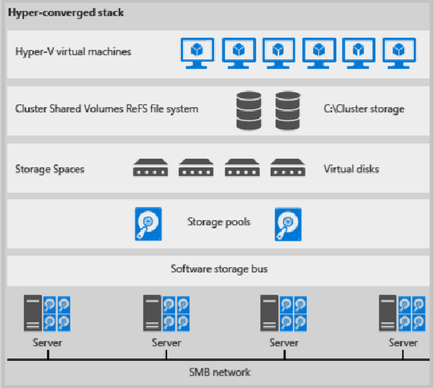
Storage Spaces Architecture
Windows Server 2025 | Chapter 8 | Managing Local Storage
18

Slide 20
Storage Replica: Overview
What it is
Block-level, volume-to-volume replication over SMB 3 — file-system agnostic
Designed for disaster recovery: replicate a volume to another server, cluster, or site
Synchronous vs asynchronous
Synchronous: zero RPO, write committed on both sides before ack — needs ≤ 5 ms RTT
Asynchronous: writes ack locally, replicate later — for high-latency or metered links
What it is NOT
Not a backup — replicates data and corruption alike; pair with backups and snapshots
Not file-level replication like DFS-R — it replicates entire volumes at the block layer
Windows Server 2025 | Chapter 8 | Managing Local Storage
19

Slide 21
Storage Replica: Three Deployment Modes
Stretch cluster
One Failover Cluster spanning two sites — automatic failover via Failover Cluster Manager
Best for HA with zero RPO when sites are within 5 ms RTT (synchronous)
Cluster-to-cluster
Two separate clusters replicate volumes between each other — manual failover
Managed via Windows Admin Center or PowerShell; sync or async
Server-to-server
Two standalone servers replicate volumes — simplest topology, manual failover
Common DR pattern for branch office to datacenter (typically asynchronous)
Windows Server 2025 | Chapter 8 | Managing Local Storage
20

Slide 22
Storage Replica: Requirements
Infrastructure
All servers joined to the same Active Directory forest
Per server: at least 2 GB RAM and 2 cores; Datacenter or Standard edition
Network ports open between nodes: SMB 445, SMB Direct 5445, WinRM 5985
Disks & volumes
GPT-formatted disks with NTFS or ReFS — replicated volume cannot live on the OS drive
Dedicated log volume on SSD, ≥ 10 GB recommended (default log size 8 GB)
Edition limits
Standard edition: 1 replicated volume, ≤ 2 TB; Datacenter: unlimited volumes and size
Windows Server 2025 | Chapter 8 | Managing Local Storage
21

Slide 23
Evolution Across Windows Server Releases
WS 2016: S2D and Storage Replica introduced — Datacenter edition only
WS 2019: SR added to Standard (1 vol / 2 TB), test failover, USB witness, mirror-accelerated parity 2× faster, 4 PB cluster scale, Windows Admin Center; shared-SAS Storage Spaces deprecated
WS 2022: SMB compression for Storage Replica reduces WAN bandwidth
WS 2025: SR Enhanced Log (raw block, replaces CLFS — no migration path), thin-provisioned S2D volumes, ReFS native dedup + compression, NVMe perf optimizations
Windows Server 2025 | Chapter 8 | Managing Local Storage
22

Slide 24
Chapter Summary
01 Build a clear mental model from physical disk to partition to volume to filesystem
02 Explain how storage choices affect performance, resiliency, and management
03 Tie local storage to later topics such as shares, permissions, and virtualization
04 Reinforce repeatable administration, validation, and supportable design choices
Windows Server 2025 | Chapter 8 | Managing Local Storage
23

Slide 25
Knowledge Check
1
What is the main administrative purpose of Disks?
2
What is the main administrative purpose of Partitions?
3
What is the main administrative purpose of Volumes?
4
What is the main administrative purpose of NTFS?
5
What is the main administrative purpose of Storage Spaces and Storage Replica?
Windows Server 2025 | Chapter 8 | Managing Local Storage
24

Slide 26
PRACTICE LAB
Lab 0801
Managing Disks, Volumes, and NTFS Permissions
In this lab, you will manage local storage on your Windows Server. You will view disk configuration, create partitions/volumes, format drives, and configure NTFS permissions. Understanding storage management is critical for server operations.
Windows Server 2025 | Chapter 8 | Managing Local Storage
25

